Slide 1




[CHAPTER]
[TOPIC]
AIAA Caltech Student Branch – 18/11/20
Preliminary Design Review – H.O.M.E.S.
Header 1
Header 2
Header 3
Body
Note

Slide 2
MISSION INTEGRATION
[TOPIC]
AIAA Caltech Student Branch – 18/11/20
Preliminary Design Review – H.O.M.E.S.
Verification Tests
Vibration Test for Deployment*
EMI Test for EDS System
Goal: Validate to TLR4
-All tests under thermal and vacuum conditions
-Implement safety factor of 1.2 – 1.5
-A minimum of 7 mats will be made based on destructive tests*
Miscellaneous
Maximum Load Test*
Abrasion Test**
Operational Test
Mechanical Load Tests
600 N Pulsating Fatigue Test*
Dust Exposure Test*
Sharp Impact Test Simulating Micrometeorites*

Slide 3
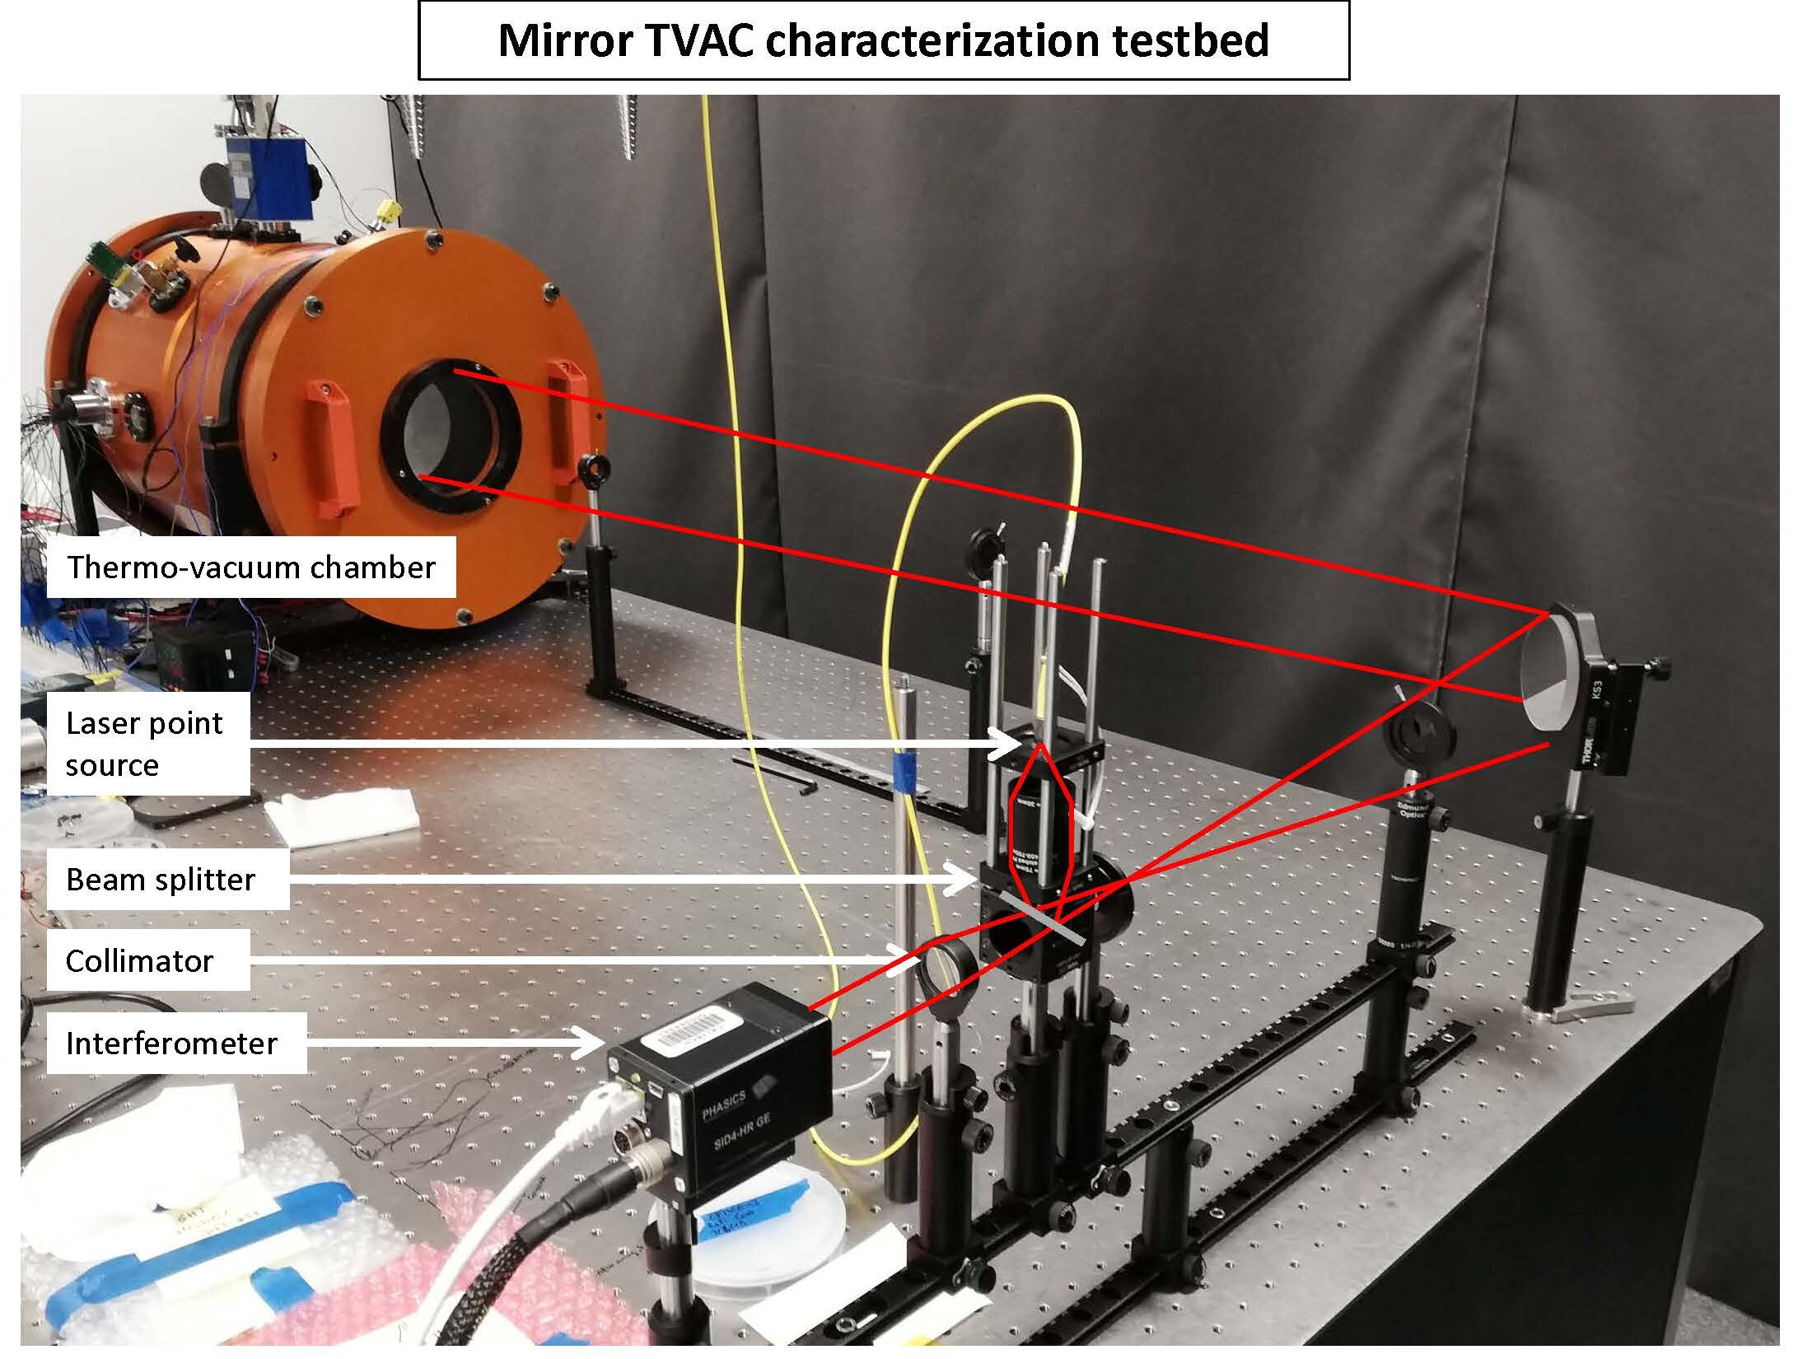
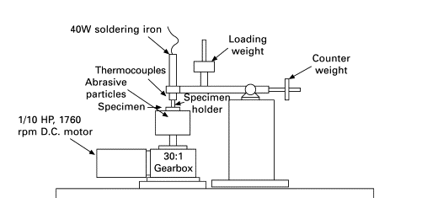
[CHAPTER]
[TOPIC]
AIAA Caltech Student Branch – 18/11/20
Preliminary Design Review – H.O.M.E.S.
Equipment
Three-Body Abrasive Wear Test Rig
Lunar Simulant JSC-1A will be used for all verification tests (similar compositional and mineralogical features)
(Roy, 2008)

